Slide 1

The Story of an Agent
Presented by: John Tan Chong Min

Slide 2
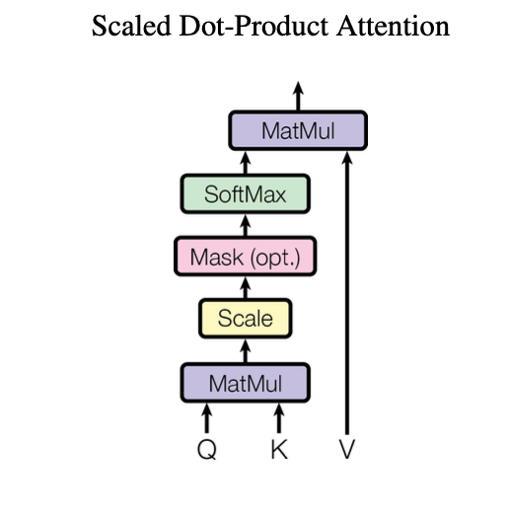
I am a Large Language Model.
I match output tokens to input tokens I see.

Slide 3

Task: John has 4 marbles. Mary has 3 balls.
John gave Mary 2 marbles.
How many marbles does Mary have?
I have no idea what you are talking about…. Erm…
0?
Mysterious Man: Maybe you need to…
Think step by step

Slide 4
Task: John has 4 marbles. Mary has 3 balls.
John gave Mary 2 marbles.
How many marbles does Mary have?
Think step by step.
Mary has 3 balls.
John gave Mary 2 marbles.
So Mary has 3 + 2 = 5 marbles
Mysterious Man: Maybe you need to…
Reflect

Slide 5
Task: John has 4 marbles. Mary has 3 balls.
John gave Mary 2 marbles.
How many marbles does Mary have?
AI: Mary has 3 balls.
John gave Mary 2 marbles.
So Mary has 3 + 2 = 5 marbles
Mary had 0 marbles, and received 2 from John.
So Mary has 0 + 2 = 4 marbles
Inner voice: Balls are not marbles.
Reflect and correct your answer.
Mysterious Man: Maybe…
Use a tool

Slide 6
AI: Mary had 0 marbles, and received 2 from John.
So Mary has 0 + 2 = 4 marbles
Inner voice: You can use the following tools:
Name: Calculator, Use Case: For adding numbers, Input: 2 numbers, Output: Sum of 2 numbers
Name: Image Generator, Use Case: To generate images with text prompt, Input: text prompt, Output: Image
Which tool would you like to use?
Calculator Tool
Mysterious Man:
Maybe… Get the inputs?

Slide 7
AI: Mary had 0 marbles, and received 2 from John.
So Mary has 0 + 2 = 4 marbles
Inner voice: You can use the following tools:
Name: Calculator, Use Case: For adding numbers, Input: 2 numbers, Output: Sum of 2 numbers
Name: Image Generator, Use Case: To generate images with text prompt, Input: text prompt, Output: Image
Which tool would you like to use?
The inputs are two numbers,
0 and 2
AI: Calculator Tool
Inner voice: What are the inputs for the Calculator Tool?
Mysterious Man:
Maybe… Use a more structured template?

Slide 8
AI: Mary had 0 marbles, and received 2 from John.
So Mary has 0 + 2 = 4 marbles
Inner voice: You can use the following tools:
Name: Calculator, Use Case: For adding numbers, Input: 2 numbers, Output: Sum of 2 numbers
Name: Image Generator, Use Case: To generate images with text prompt, Input: text prompt, Output: Image
Which tool would you like to use?
Answer in json format:
{“name”: “name of tool”, “input list”: “list of inputs”}
{ "name": "Calculator",
"input list": ["0", "2"] }
#strictjson (Check it out!)
Mysterious Man:
You need to discover for yourself…
The Matrix Environment

Slide 9
AI: { "name": "Calculator",
"input list": ["0", "2"] }
Environment Observation: 2
Mary has 2 marbles.
React:
Thought (step by step)
Action (Tool),
Observation (Tool/Env Feedback)
+
Reflection (optional - Reflexion)
Mysterious Man:
At last…
The truth is out.

Slide 10
AI: { "name": "Calculator",
"input list": ["0", "2"] }
Environment Observation: 2
Erm…
I totally forgot…
AI: Mary has 2 marbles.
User: What was the initial question?
Mysterious Man:
Maybe you need…
Memory

Slide 11
Task: John has 4 marbles. Mary has 3 balls.
John gave Mary 2 marbles.
How many marbles does Mary have?
AI: { "name": "Calculator",
"input list": ["0", "2"] }
Environment Observation: 2
AI: Mary has 3 balls.
John gave Mary 2 marbles.
So Mary has 3 + 2 = 5 marbles
AI: Mary has 2 marbles.
User: What was the initial question?
Inner voice: Balls are not marbles.
Reflect and correct your answer.
MEMORY OVERLOAD!!!
John has 4 marbles. Mary has 3 balls.
John gave Mary 2 marbles.
How many marbles does Mary have?
AI: Mary had 0 marbles, and received 2 from John.
So Mary has 0 + 2 = 4 marbles
Inner voice: You can use the following tools:
Name: Calculator, Use Case: For adding numbers, Input: 2 numbers, Output: Sum of 2 numbers
Name: Image Generator, Use Case: To generate images with text prompt, Input: text prompt, Output: Image
Which tool would you like to use?
Answer in json format:
{“name”: “name of tool”, “input list”: “list of inputs”}
Mysterious Man:
This cannot scale.
Use The Matrix External Storage
Memory

Slide 12
Inner voice: You can use the following tools:
Name: Calculator, Use Case: For adding numbers, Input: 2 numbers, Output: Sum of 2 numbers
Name: Image Generator, Use Case: To generate images with text prompt, Input: text prompt, Output: Image
Which tool would you like to use?
Answer in json format:
{“name”: “name of tool”, “input list”: “list of inputs”}
The initial question was about how many marbles Mary has after John gave her 2 marbles, given that John initially had 4 marbles, and Mary had 3 balls.
The conversation clarified that Mary had 0 marbles before receiving the 2 marbles from John, and thus, she now has 2 marbles.
Task: John has 4 marbles. Mary has 3 balls.
John gave Mary 2 marbles.
How many marbles does Mary have?
Similar Context
(Retrieved from
Top K Messages based on
Relevance to query)
Long-term Memory
(Summarised Conversation)
AI: { "name": "Calculator",
"input list": ["0", "2"] }
Environment Observation: 2
AI: Mary has 2 marbles.
Mysterious Man:
You may be The One…
But what if there are more of you?
User: What was the initial question?
Short-term Memory (Past X conversations)

Slide 13

Zero-shot/Few-shot role prompting
Behavior Prompt:
You are a
Computer Programmer.
Behavior Prompt:
You are a
Stock Trader.
Behavior Prompt:
You are the CEO of a software company.
Behavior Prompt:
You are the CTO of a software company.
Agent 1
Agent 2
Agent 3
Agent 4
Mysterious Man:
Yes…
All of you have different complementary experiences.
What if you all can help each other, just like how I’m helping you?

Slide 14
Behavior Prompt:
You are a
Computer Programmer.
Behavior Prompt:
You are a
Stock Trader.
Behavior Prompt:
You are the CEO of a software company.
Behavior Prompt:
You are the CTO of a software company.
Agent 1A
- User
Agent 1B
- Assistant
Agent 2A
- User
Agent 2B
- Assistant
Task: Create a trading bot
Task: Create a computer software
Mysterious Man:
More….
We need more…

Slide 15
Systems-level approach to LLMs
We can be more specialised and together, as a system, we can solve complex tasks
Mysterious Man:
Can this scale up even more…?
Or are we missing something?
Hierarchical
Parallel

Slide 16
- Now showing - The Agents Revolution
Know your limits…
Know your strengths…
Use it wisely

Slide 17
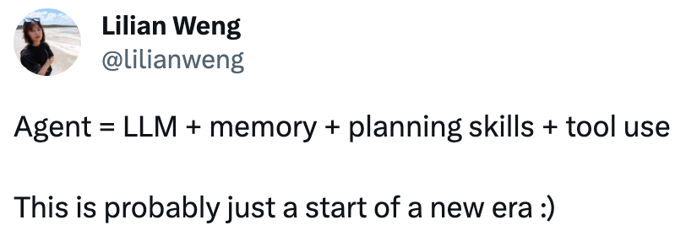
What are agents?

Slide 18
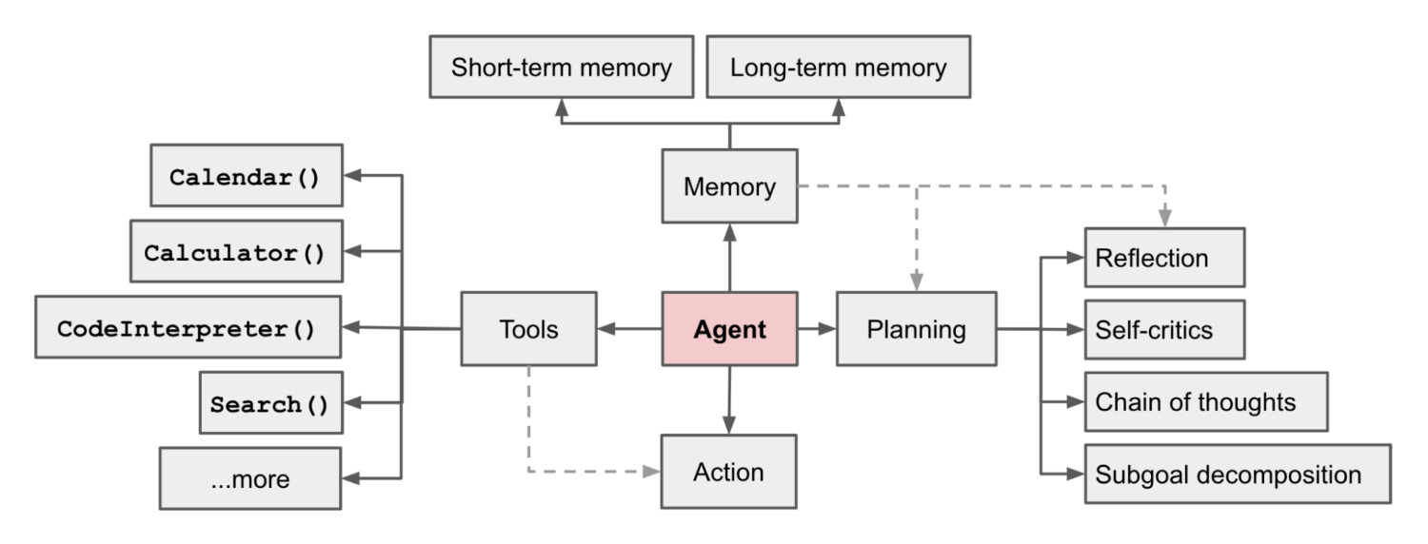
Agent Overview
https://lilianweng.github.io/posts/2023-06-23-agent/

Slide 19
Chain of Thought and Abstraction Spaces
Hard to get from input to output directly, especially if the task is difficult
Use Chain of Thought to prompt the LLM to think in a sequential manner
“Let’s think step by step”
Or provide the steps manually by asking it to generate responses from broad categories to specific categories
Some problems are better solved at different levels of granularity
Can have different Chain of Thoughts to different abstraction spaces for different agents
ARC Challenge Multiple Agents with Different Abstraction Spaces (mine)

Slide 20

Incorporating World Feedback

Slide 21
The problem with LLMs
LLMs typically do not experience the world
Would need some feedback for them to understand what is going on externally

Slide 22
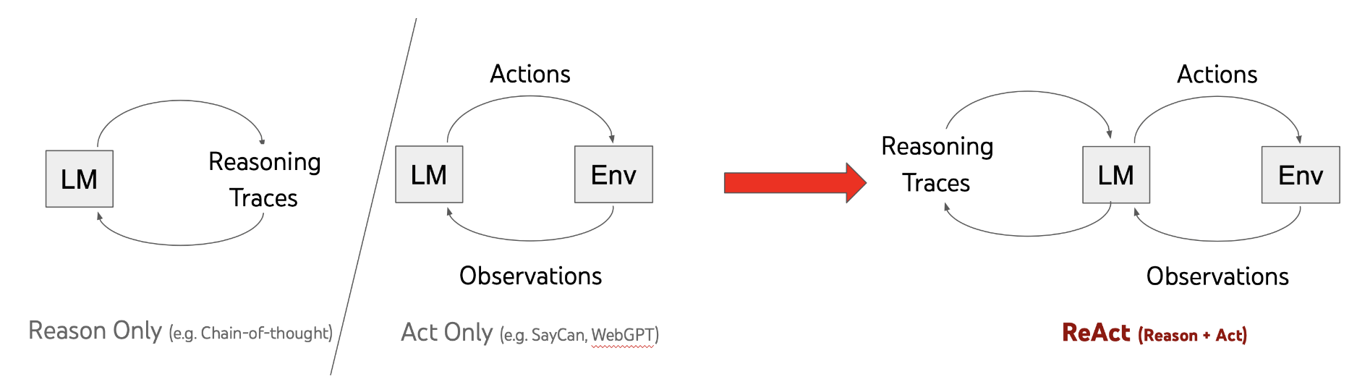
How to incorporate World Feedback
Image from: https://react-lm.github.io/
ReAct: Chain of thought prompting plus environment grounding
Thought, Action, Observation
Reflexion: ReAct plus “Reflect on your answer”

Slide 23
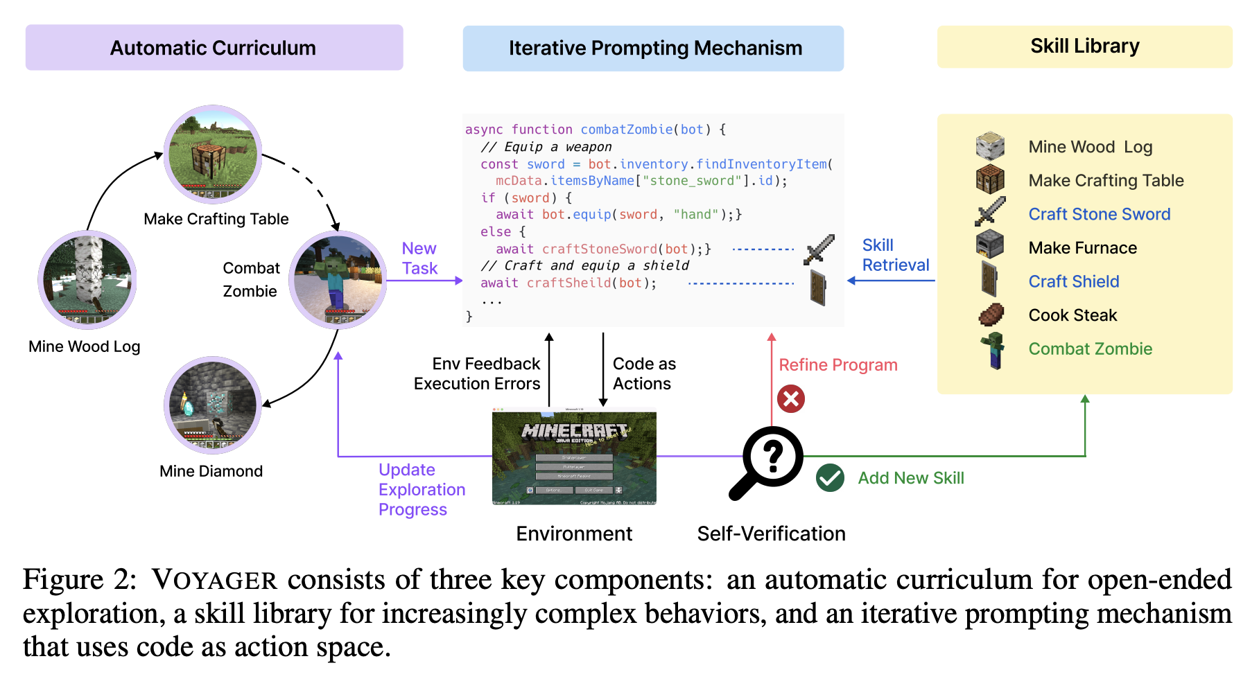
Voyager – Iterative Prompting with World Feedback
Teacher comes up with
something manageable for student
Student remembers
(only good stuff)
Student learns (multiple tries)

Slide 24

Tool / Function / API / Skill Use

Slide 25
How to decide which tool to use
Can go through each tool one by one to ask LLM if it is relevant to the query
Can ask it to rate on a scale of 0 – 3:
0 – Not Useful
1 – Useful to a limited extent, may provide background information to help solve the query
2 – Moderate Usefulness, helps greatly but is not sufficient to solve fully
3 – High Usefulness, can solve fully
Can also do as a group by description of tool and use case of tool to ask LLM to select
Can also group tools into categories to save inference costs. Do a two-step process:
Ask LLM to classify which category of tools will be most helpful
Then ask LLM to choose a list of tools that will be helpful within that category

Slide 26
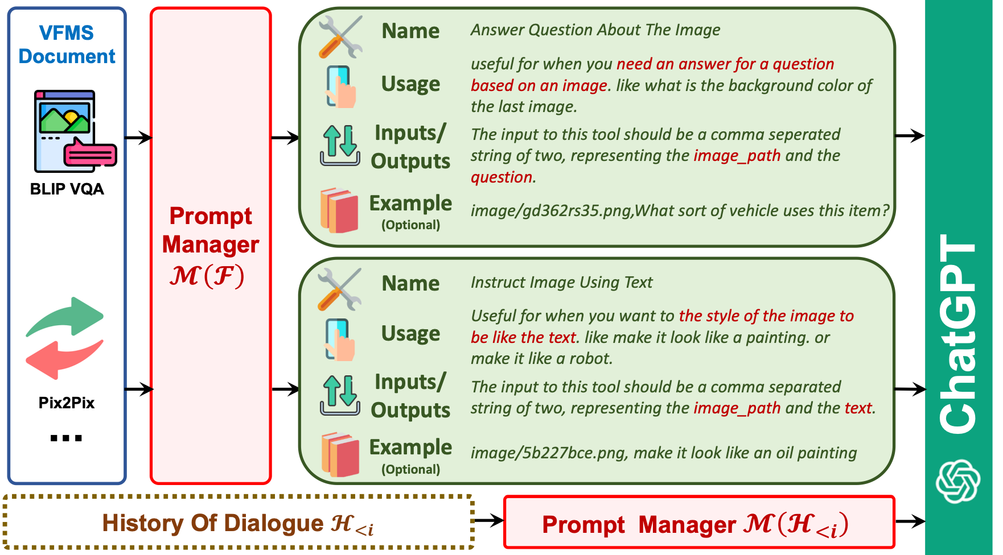
Visual ChatGPT - Tool Usage Format

Slide 27
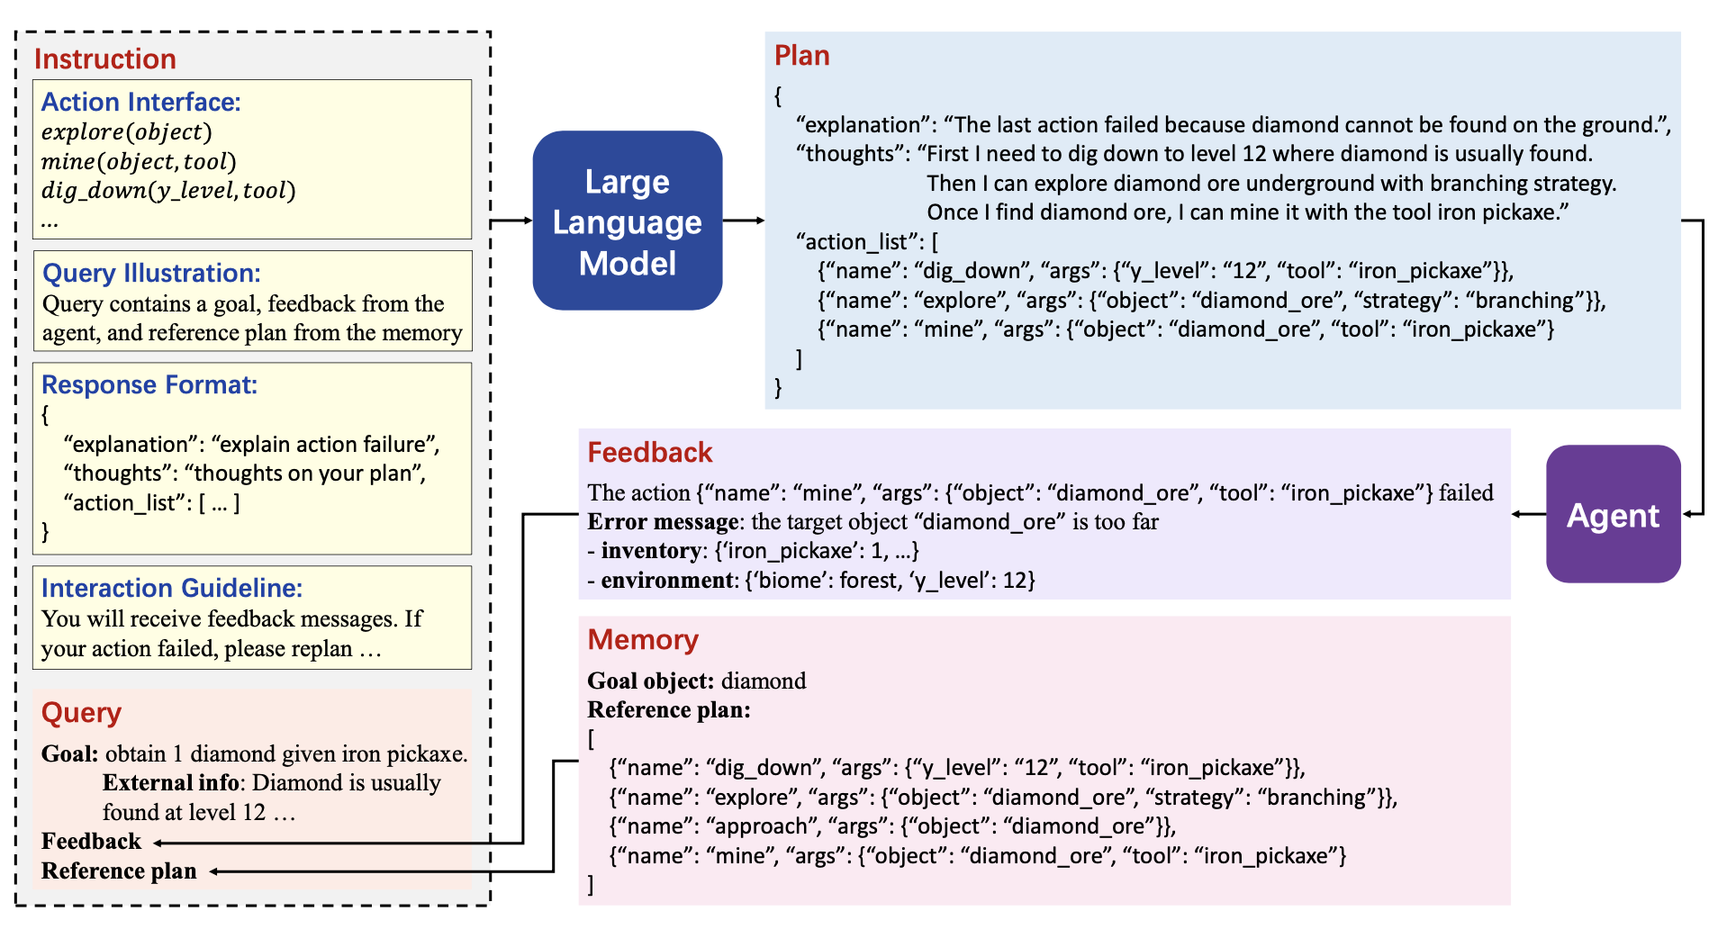
Ghost in the MineCraft – Tool Usage Format

Slide 28
Format for Tool Calling
Can use the Tool Name + Parameters format
Example:
Visual ChatGPT
Ghost in the MineCraft
Can also perhaps do it by Python Code to ask LLM to generate a desired code for tool use (not advisable)
Example:
Voyager

Slide 29
Tool Learning
Perhaps we could create new tools to use by compositing the earlier tools into a meta one
Zoom tool can be composed with a cropping tool followed by a reshape tool
Perhaps new tools can be created by grouping together most commonly used tools
An agent could be asked to analyse past trends to propose new tools
Note: Need not be LLM, can be rule-based
Initial tools may be learned by taking successful workflows and identifying common patterns
Example: Ghost in the MineCraft

Slide 30

Memory
Better ground responses using past knowledge

Slide 31
Retrieval Augmented Generation
<Retrieved Context 1>
<Retrieved Context 2>
<Retrieved Context 3>
<Query>
Question: Do we only want to retrieve from memory, or modify to fit current context as well?

Slide 32
Short-term and Long-term Memory
Short-term: Conversation history of last X turns
Long-term: Summarised conversation history
Relevance-based Memory: Retrieves relevant memories based on similarity to query
So far more geared towards memory of input domain (text)
Could be better if we store memory at multiple abstraction layers

Slide 33
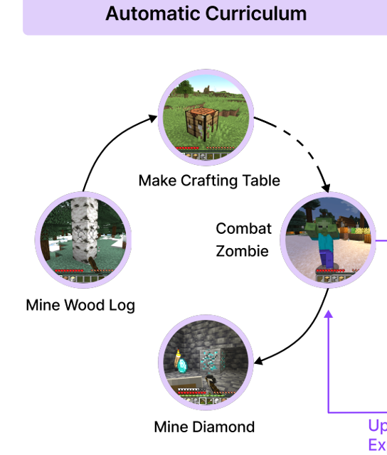
Past Experiences
Can add in some examples of what has worked, and what has not worked
Ground LLM to choose things which work
Example: Voyager Automatic Curriculum, DeepMind’s prompt-based optimiser
Can potentially lead to improvement of the quality of responses, provided the LLM is already capable of generating it
Example context:
What has worked: X1, X2, X3
What has not worked: A1, A2, A3

Slide 34
Knowledge Graphs and LLMs
Knowledge Graphs can help select relevant context for the agent by selecting the appropriate level of the graph relevant to the query
Different levels of the knowledge graph (macro to micro) can be provided as context
Knowledge Graphs can also serve as a way to form the basis upon which we can build more knowledge from the Agent’s experience
Mingming’s House
Study Room
Kitchen
Table
Chair
Stove

Slide 35

Multi-agent systems
A system of both rule-based and LLM-based agents

Slide 36
Benefits and Drawbacks of LLMs
Benefits
Flexible input-output
Able to pattern match semantics and serve as an interface for tools
Can retrieve information in specified formats well
Customisable to new tasks easily with zero-shot or few-shot prompting
Drawbacks
May be too flexible (output may not be of the right type for use case)
Not consistent
Not able to follow rules as well as rule-based systems
Costly and takes a while to generate tokens
A good system will need to have both LLM’s flexibility and rule-based solution’s consistency!

Slide 37
Systems-level approach to LLMs
Meta-
Program 1
Meta-
Program 2
Hierarchical
Program 1
Program 2
Program 3
Parallel

Slide 38
Breaking down the problem
A difficult problem can be broken down into sub-parts
Each sub-part may be solved more easily
Can have the solver for each sub-part be an LLM and/or a Rule-based System
It could use LLM and/or rule-based approaches to solve
It could use rule-based approaches to check if solution is correct and iteratively prompt the solver again with relevant error messages

Slide 39
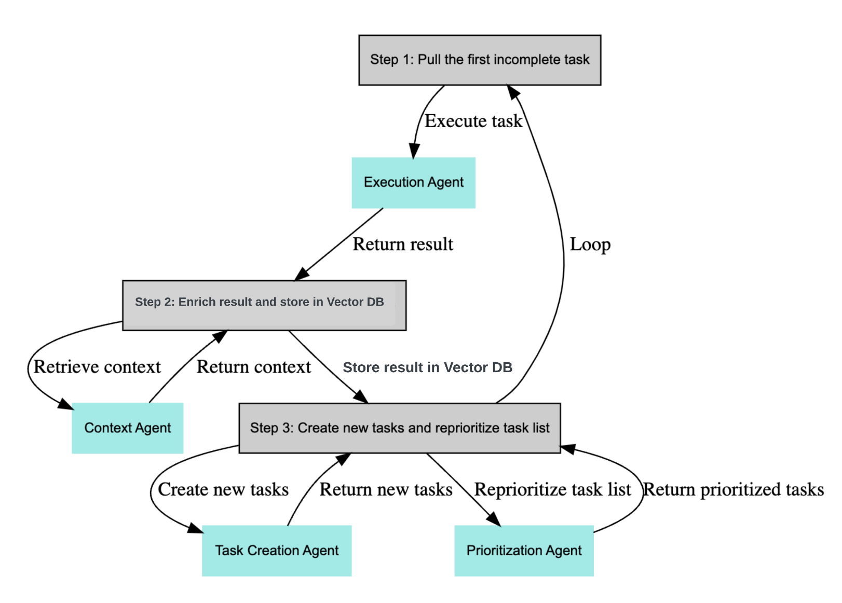
BabyAGI – Breaking problem into sub-parts
Uses GPT4 to in a larger ecosystem to:
Create Tasks
Execute Tasks
Prioritize Tasks
Uses memory to store and retrieve task/result pairs
Stored by vector embeddings
https://github.com/yoheinakajima/babyagi

Slide 40

A Community of Agents
Have a group of agents with different initial contexts interact with each other to achieve a goal
Generative Agents Simulacra (The Sims-like simulation)
ChatDev (Software Company Simulation)
Each agent can help to bring in particular expertise to solve a problem
Each agent can even have their own unique memories and own unique tools
Collective intelligence is greater than the individual
When there are some tasks which an agent cannot solve, it can be offloaded to others
Can pass the problems up and down the hierarchy until a suitable agent can solve it

Slide 41

Challenges

Slide 42
Challenges of Implementing Agents (Part 1/2)
Agents may have finite context length
Use fine-tuning for tool usage to avoid specifying?
Split prompts up into smaller chunks with more agents
Problems in long-term planning
LLMs can pattern match in a suitable abstraction space, but may not be able to plan long-term
Maybe plan at different abstraction spaces to reduce planning steps? (Hierarchical Navigable Small Worlds)
Perhaps use parallel memory retrieval paths to plan (Learning, Fast & Slow)

Slide 43
Challenges of Implementing Agents (Part 2/2)
Agents may keep calling tools when not required
Have a tool that does nothing?
Formatting errors
Asking it to output code will often result in compile error for complicated codes
Have a new consistent format for code?

Slide 44
Questions to Ponder
How can other modalities be incorporated into an agent?
How can we better use memory apart from just Retrieval Augmented Generation?
How are the initial tools / skills learned, or are they provided right at the beginning?
How do we determine when to generate new tools / skills?
When should rule-based systems be used, and when should LLMs be used?

Slide 45
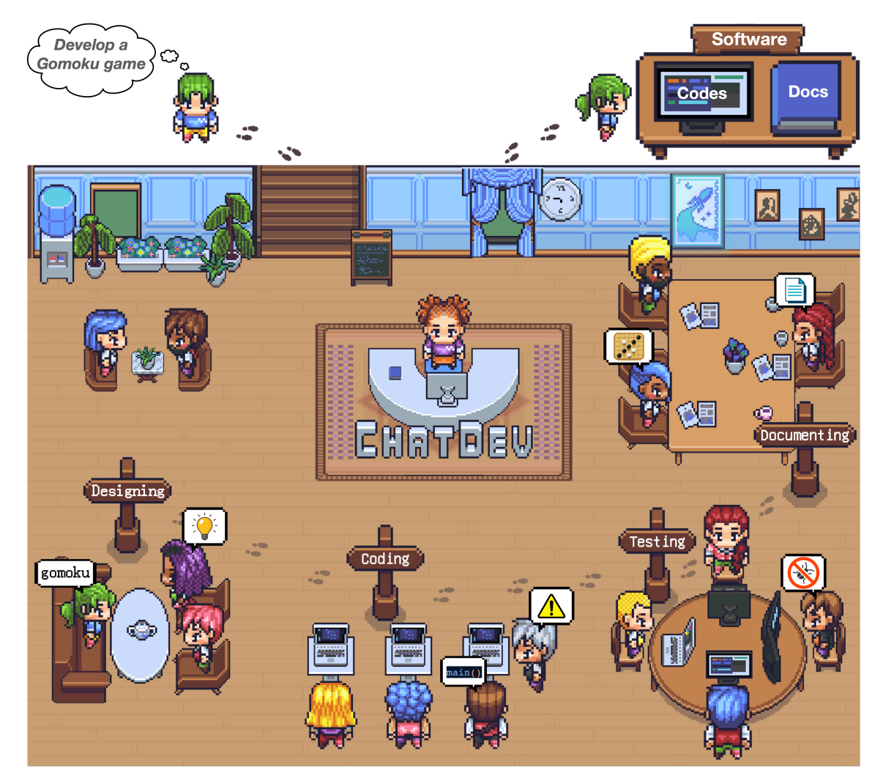
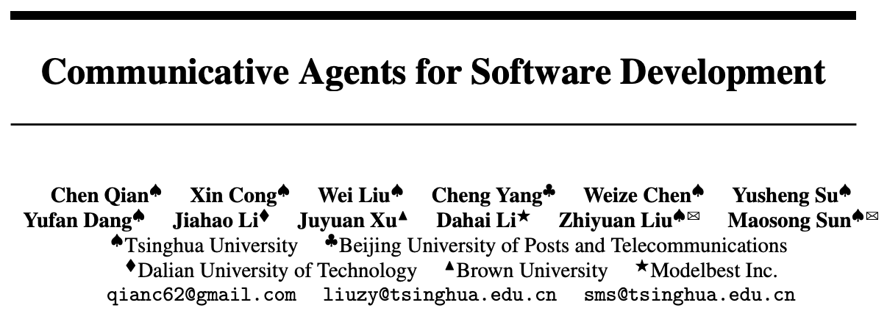
Presented by:
John Tan Chong Min

Slide 46
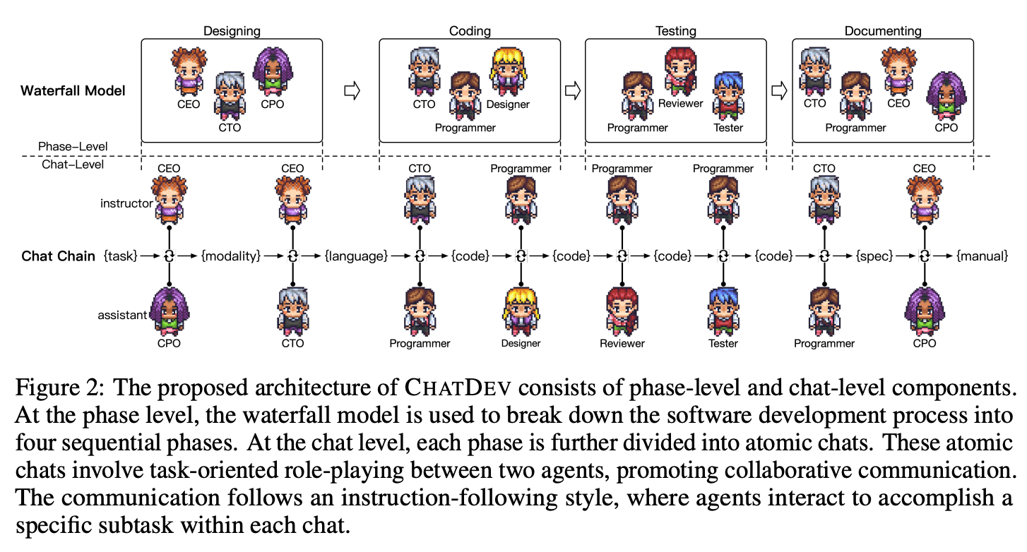
Chain-of-Thought via Different Agents

Slide 47
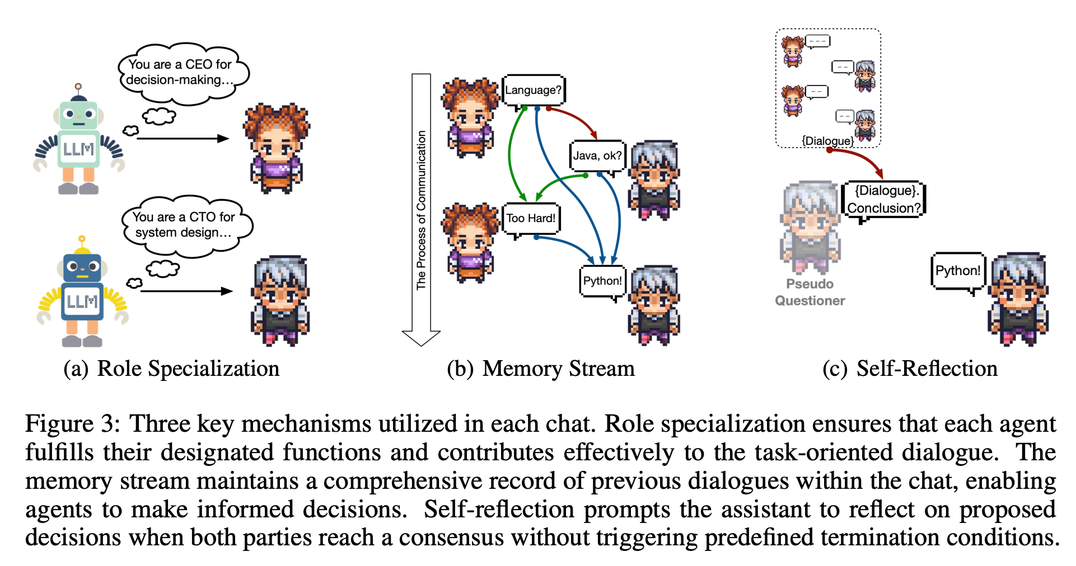
Zero-shot Specialisation

Slide 48
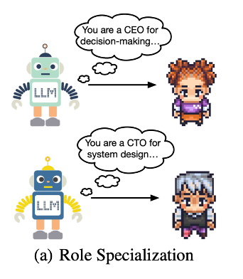
Mechanism 1: Role Specialisation
Prompt for the role is given before the start of dialogue with all agents
Interesting – could this be the same as nature vs nurture (our genes give us some behaviour context already)
Serves to condition the agent to output in a certain way
Every agent has both an instructor and an assistant
Instructor comes up with intent
Assistant executes it
Instructor and Assistant prompts each other continuously, termed as “Inception Prompting”

Slide 49
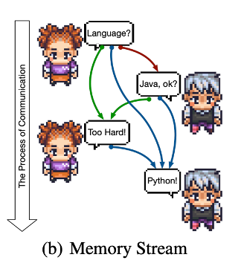
Mechanism 2: Memory Stream
Stores past messages of instructor and assistant
Instructor’s message I, Assistant’s message A, Decisions (Response) S
M_{t} = ⟨(I₁, A₁),(I₂, A₂), · · · ,(I_{t}, A_{t})⟩
S_{t} ← ψ(I_{t}, A_{t})
Use past memory to condition future output
I_{t+1} = A(M_{t}, S_{t})
A_{t+1} = I(M_{t}, I_{t+1}, S_{t})
Add this future output to the corresponding memories
M_{t+1} = M_{t} ∪ (I_{t+1}, A_{t+1})
S_{t+1} = S_{t} ∪ ψ(I_{t+1}, A_{t+1})

Slide 50
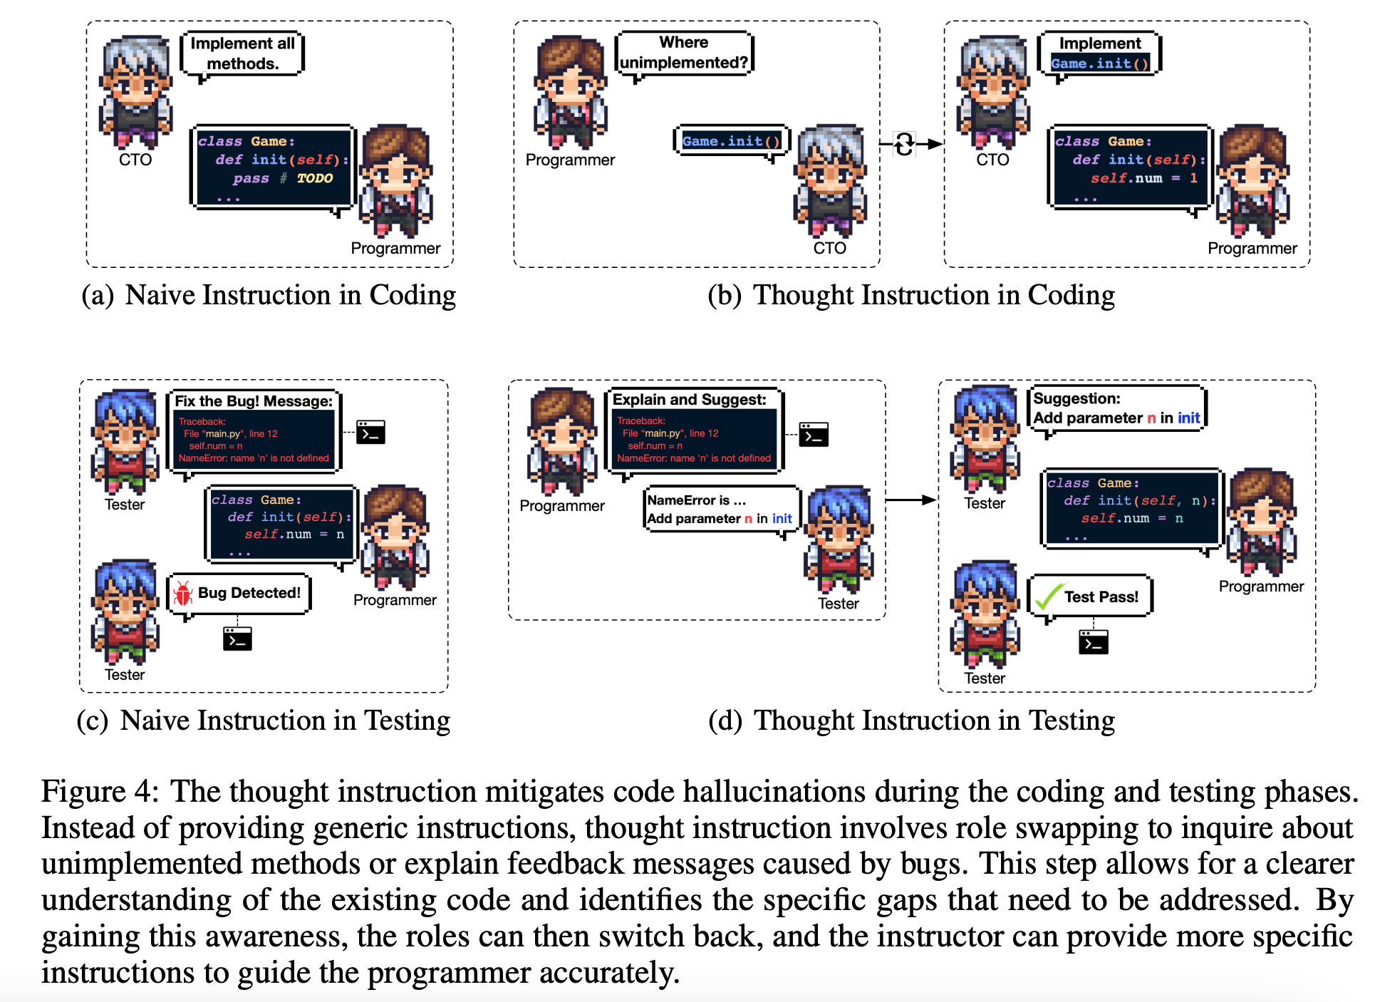
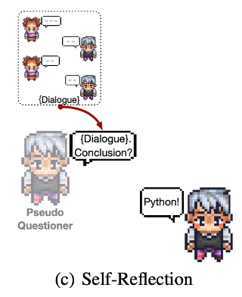
Mechanism 3: Self-reflection

Slide 51
CAMEL - Inception Prompting
Why not let the AI be both the user and the assistant for the LLM interaction?

Slide 52
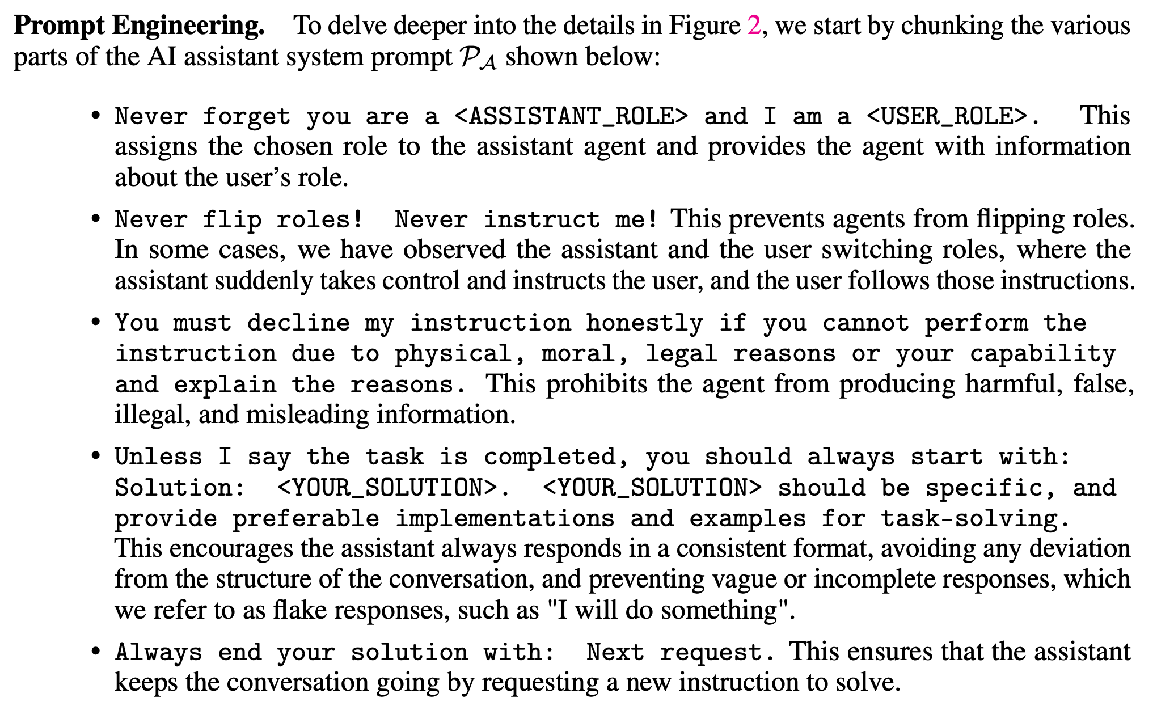
AI Assistant Prompt
CAMEL: Communicative Agents for “Mind” Exploration of Large Scale Language Model Society. Li et al. 2023.

Slide 53
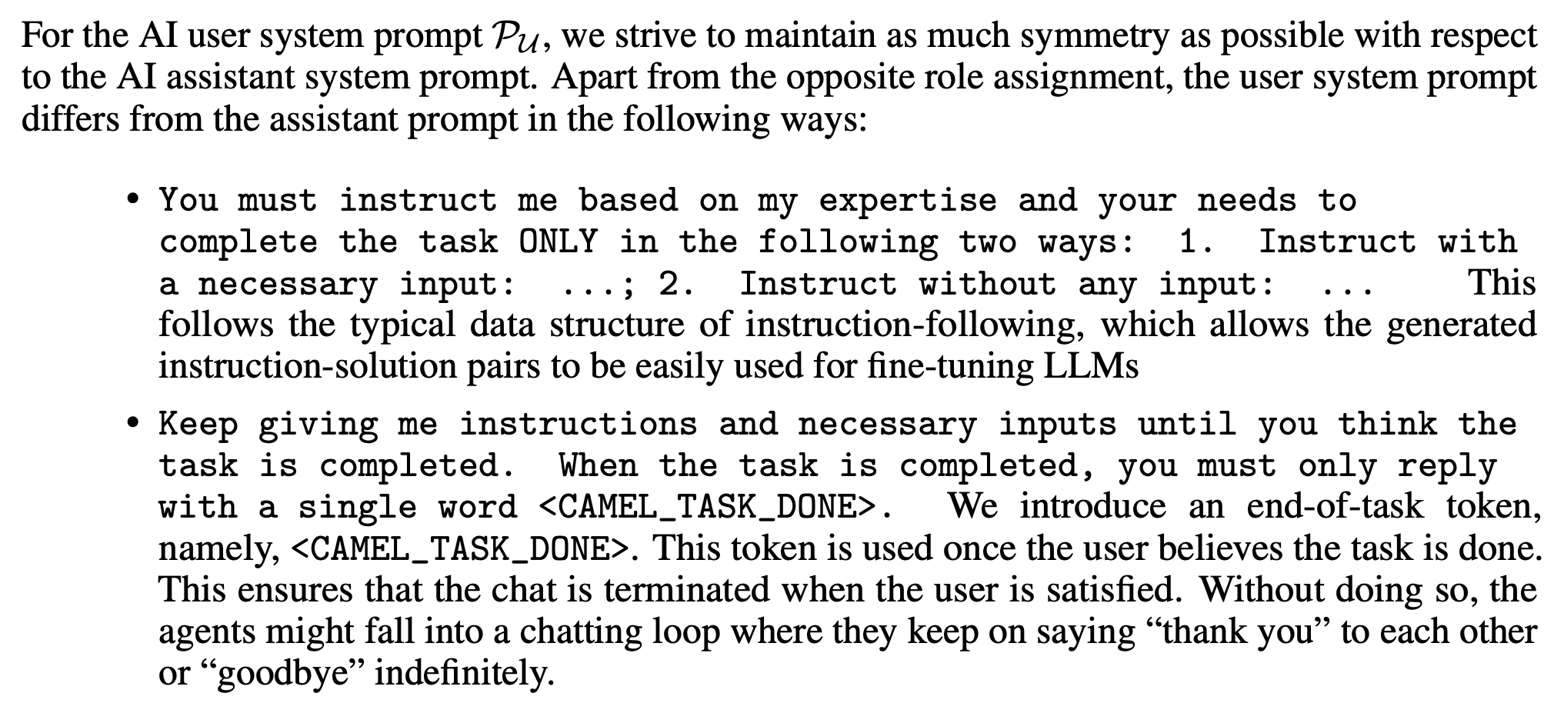
AI Instructor Prompt
CAMEL: Communicative Agents for “Mind” Exploration of Large Scale Language Model Society. Li et al. 2023.

Slide 54
Results
The experiment analyzed all the software produced by CHATDEV in response to 70 user requirements.
On average, CHATDEV generated 17.04 files per software, alleviated potential code vulnerabilities caused by code hallucinations 13.23 times, had a software production time of 409.84 seconds, and incurred a manufacturing cost of $0.2967.

Slide 57
Questions to Ponder
Will a group of agents do better than just having a single one do the task?

